Slide 1
Hypervisor Anomaly Detection Multivariate time series analysis
Lecture at Technical University of Berlin
Jorge Cardoso
Chief Engineer for Hyperscale AIOps
Munich Research Center
2022.04.12

Slide 2
Indirect Hypervisor Anomaly Detection Description
Background. Hypervisors create and manage virtual machines (VMs). As public clouds become critical infrastructures, the reliability of hypervisors and VMs becomes increasingly important.
Problem. However, the reliability of the virtualization layer has not been properly addressed and mechanisms to evaluate its health are limited. For example, if a hypervisor faces a fail-stop or gray failure, the failure is propagated to all hosted virtual machines. This makes production VMs dependent on a single point of failure.
Objective. The objective of this research is to detect anomalous hypervisors based on the behavior of the VMs they manage.
Approach. Thus, to identify hypervisors that are experiencing failures, we developed the HAD (Hypervisor Anomaly Detection) algorithm. The objective is to preemptively migrate VMs to another hypervisor when the underlying hypervisor is faulty. HAD design was inspired on Attribution Theory. HAD observes and learns the behavior of metrics of individual virtual machine running on a hypervisor. When a VM exhibits a different behavior, HAD determines if the behavior is intrinsic to the VM or it is observed across several VMs. Finally, the algorithm attributes the observed behavior to either internal causes (e.g., a VM is stressed because it is running a CPU intensive application) or external causes (e.g., a hypervisor failure).
Results. HAD is an online algorithm which achieves up to 14x speed improvement when compared to its offline implementation. It implements a new online algorithm for root-cause attribution. It was evaluated with metrics collected from VMs running on Azure cloud and an F1 score of >90% was achieved.

Slide 3
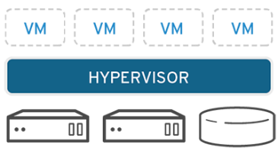
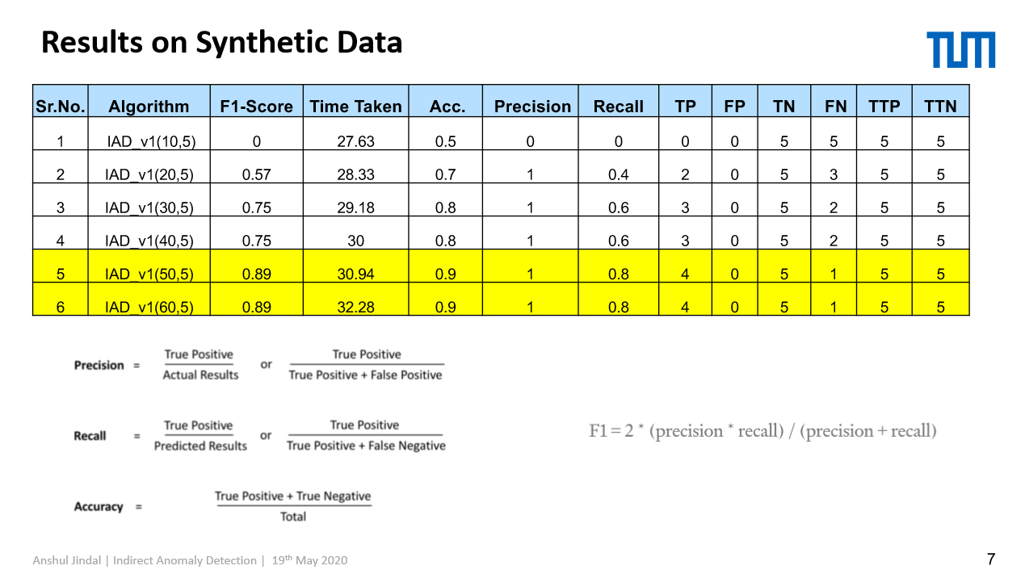
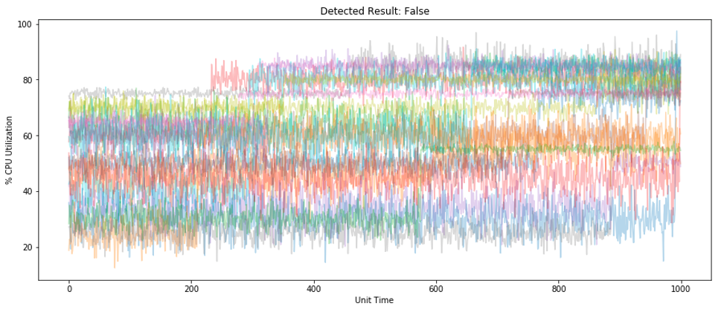
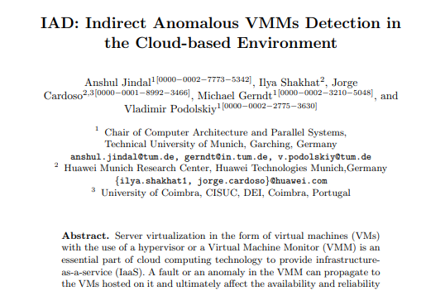
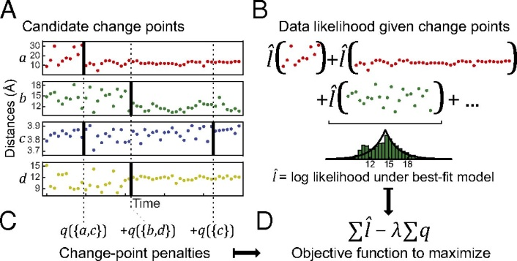
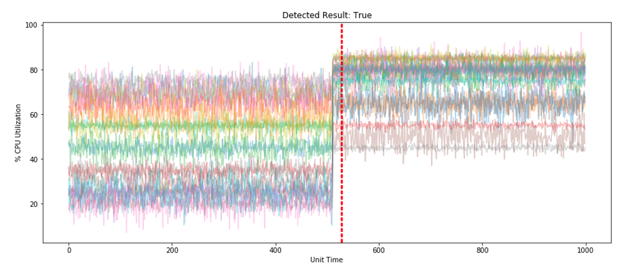
Indirect Hypervisor Anomaly Detection Detecting Faulty Hypervisors using VMs Metrics
Virtualization failures affect VMs but cannot be observed directly
MAIN ACHIEVEMENT
HAD algorithm – quorum change-point detection
Analyzes individual time-series, and uses change points and voting to decide whether there is an hypervisor malfunction
Key results: F1 score 72% (data from 2 VMs); 80+% (3+ VMs)
Predictive Maintenance for Hypervisors
Migrate customers’ VMs before hypervisors completely fail
Fig. VM exhibit abnormal behavior when the hypervisor has technical issues
Analyze VM resources to detect correlated anomalies
HOW IT WORKS
Problem
Hypervisors do not have effective methods to determine their health
Method 1 (Change Points)
Treat time-series as univariate
Detect change points
Vote to decide global changes
Method 2 (Isolation Forest)
Treat time-series as features
Detect significant changes
Method 3 (ECP E.Divisive)
Treat time-series as multivariate
Detect multiple change points
VM
VM
VM
VM
Benefits
Reduce the number of VMs crashes due to hypervisor failures in 80%
VM
VM
VM
VM
Normal
VM
VM
VM
VM
VM
VM
VM
VM
VM
VM
VM
VM
VM
VM
VM
VM
Indirect approach to detect hypervisor failures by monitoring VMs
Normal
VM
VM
VM
VM
VM
VM
VM
VM
VM
VM
VM
VM
VM
VM
VM
Correlated
anomalies
Anomaly
VM
Fig. Several time-series generated by several VMs running in the same hypervisor
VM
VM
VM
VM
VM
VM
VM
VM
ASSUMPTIONS & LIMITATIONS
Datasets used for evaluation were collected from simulation environment, synthetic data generator and public sources
Insight. Resource saturation of VMs suddenly changes, within a window w, when an hypervisor is malfunctioning
IAD: Indirect Anomalous VMMs Detection in the Cloud-based Environment. Jindal, A.; et al.. AIOPS 2020 International Workshop on Artificial Intelligence for IT Operations, Springer, 2021
TRL 5. Basic technological components are integrated with realistic supporting elements so it can be evaluated in test environment

Slide 4
Problem Definition Limited Health Monitoring
Background
Hypervisors manage virtual machines (VMs)
As public clouds become critical infrastructures, the reliability of hypervisors becomes increasingly important
Problem
For example, if a hypervisor faces a fail-stop or gray failure, the failure is propagated to all hosted virtual machines
This makes production VMs dependent on a single point of failure.
Approach
Existing mechanisms to evaluate the health of hypervisors is limited
Observes and learns the behavior of metrics of individual VM running on a hypervisor
(next slide discuss the type of behavior monitored)
When VMs exhibit different behaviors, determine if the behavior is intrinsic to VMs or it is observed across several VMs
normal
normal
failure propagation
abnormal
VM
VM
VM
VM
VM
VM
VM
VM
VM
VM
VM
VM
VM
VM
VM
VM
VM
VM
VM
VM
VM
VM
VM
VM
VM
VM
VM
VM
VM
VM
VM
VM
VM
VM
VM
VM
VM
VM
VM
VM
VM
VM
VM
VM
VM
VM
VM
VM
Hypervisor
(e.g., KVM)
Hypervisor
Hypervisor
Possible root
causes
IaaS Layer
IaaS Layer
IaaS Layer
Host
192.168.5.11
Host
192.168.5.12
Host
192.168.5.15
Get metrics from
SQL: I give the IP: 192.168.5.11
1. All VMs running in the IP hypervisors (MEM, CPU, IO) OK
2. IaaS layer processes (CPU user, system, i/o)
3. Host IP: MEM, CPU, IO
I don’t know the SQL query, the db, the fields.
CloudAgent / Kafka
Monitoring Database
CAD / HAD
192.168.5.11 OK health report
192.168.5.12 OK health report
192.168.5.15 ERROR health report

Slide 5
Problem overview
Compute service
Monitoring
VM₁
VM_{N}
VM monitoring is not available
VMs belong to customers and do not have monitoring agents inside
Platform monitoring
BM host metrics:
CPU, network IO, disk IO
per-VM metrics:
total CPU utilization
total memory allocation (virtual memory assigned to VM)
network IO (packet transmitted and received, error count) per network card
storage IO (bytes read and written, timings) per volume attached to VM
Hypervisor
Tenant networking
metrics
Storage
virtualization platform
Problem statement
Failures of virtualization platform affect VMs but could not be observed directly.
Example 1: network storage throughput is affected by failure, causing latency in all disk operations in all VMs
Example 2: tenant networking is affected by packet loss in underlying vxlan tunnel, it cannot be measured directly on tunnel level, but affects TCP traffic between VMs.
Proposed solution
By knowing the model of VMs’ behavior, check if it persists over the time. Simultaneous change for all VMs may indicate problems in the virtualization platform.
Challenges
Type of VM workload is not known, it may even change during VM lifetime
Many VMs could be in almost idle state
VMs change over the time (some come, some go)

Slide 6
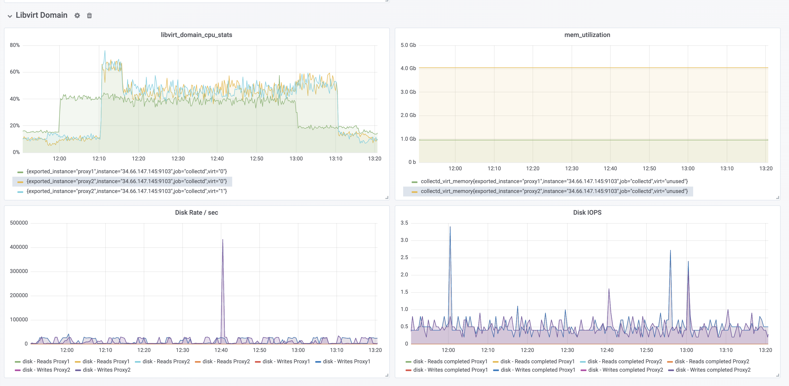
Hypervisor Health Behavior Evaluation
Store
VM metrics
Our experiments indicate that the best way to detect the failure of hypervisors is to monitor the CPU usage of VMs
Observation
We analyzed the effect of overloading the host running the hypervisor
4 metrics were monitored: CPU, MEM, Disk Rate and IO
CPU metric is the most affected and visualized parameters in the VMs
CPU in the Virtual machines decreases if there is certain workload going on them
CPU in the virtual machines increases if there is no workload going on them
All or most of the virtual machines are affected when a load is introduced on hypervisor
Further research
How generic and representative is the fault (i.e., hypervisor load)?
Monitoring Agents
VM1
VM2
InfluxDB
Application Containers
Monitoring Agents
Application Containers
Monitoring Agents
Prometheus
libvirtd
Stress-ng
Ubuntu 18.04
Ubuntu 18.04
Grafana
Other Userspace Processes
vCPU0
…
vCPU4
vCPU0
…
vCPU4
QEMU-KVM
QEMU-KVM
Linux Kernel
KVM Kernel Module
Ubuntu 18.04 VM
CPU
MEM
Disk rate
Disk IO
Observe
metric behavior
Load generated on hypervisor affected the
VMs CPU utilization

Slide 7
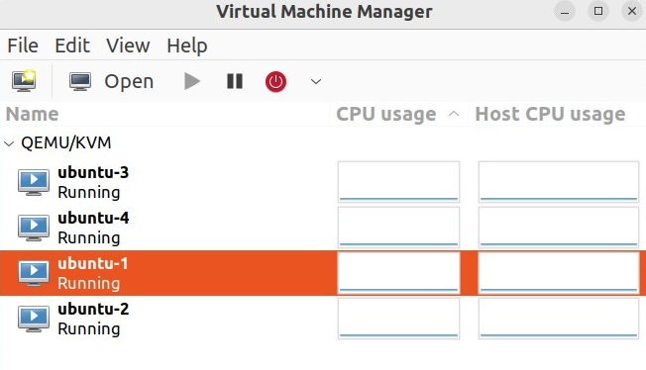
KVM
KVM (Kernel-based Virtual Machine) hypervisor is a kernel module (kvm.ko). The process that runs KVM is typically the QEMU (Quick Emulator) process.
KVM/QEMU combination works as follows:
KVM Module: Loaded into the Linux kernel. It provides the necessary infrastructure for hardware-assisted virtualization.
QEMU Process: User-space emulator that interfaces with the KVM kernel module for creating and managing virtual machines.
When starting a virtual machine using qemu-system-x86_64, it launches a QEMU process that calls KVM module:
qemu-system-x86_64 -enable-kvm -cpu host -m 2048 -hda your_disk_image.qcow2
-enable-kvm: Enables KVM for hardware virtualization.
-cpu host: Uses the host CPU features.
-m 2048: Allocates 2 GB of RAM for the virtual machine.
-hda your_disk_image.qcow2: Specifies the disk image for the virtual machine
Tools such as libvirt or virt-manager abstract the details of starting KVM/QEMU virtual machines.
$ ps -ef | grep qemu-system-x86_64
libvirt+ 756677 1 0 Dez14 ? 00:14:21 /usr/bin/qemu-system-x86_64 -name guest=ubuntu-1,debug-threads=on -S -object {"qom-type":"secret","id":"masterKey0","format":"raw","file":"/var/lib/libvirt/qemu/domain-50-ubuntu-1/master-key.aes"} -machine pc-q35-6.2,usb=off,vmport=off,dump-guest-core=off,memory-backend=pc.ram -accel kvm -cpu host,migratable=on -m 2048 -object {"qom-type":"memory-backend-ram","id":"pc.ram","size":2147483648} -overcommit mem-lock=off -smp 2,sockets=2,cores=1,threads=1 -uuid 283f1e7c-c249-44b7-bcd5-b48e406c32e4 -no-user-config -nodefaults -chardev socket,id=charmonitor,fd=43,server=on,wait=off -mon chardev=charmonitor,id=monitor,mode=control -rtc base=utc,driftfix=slew -global kvm-pit.lost_tick_policy=delay -no-hpet -no-shutdown -global ICH9-LPC.disable_s3=1 -global ICH9- …
ps -ef | grep qemu-system-x86_64
https://virt-manager.org/

Slide 8
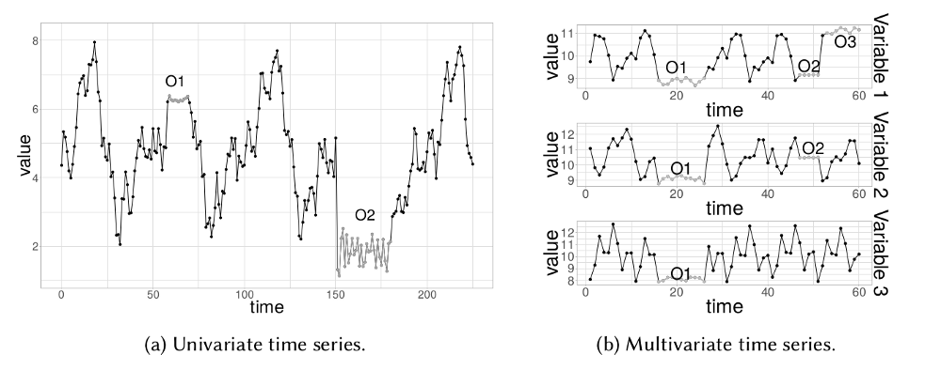
Theory Anomaly detection for multivariate time series
Model | Paper reference
PCA | [2003] Shyu M L, Chen S C, Sarinnapakorn K, et al. A novel anomaly detection scheme based on principal component classifier
iForest | [ICDM'2008] Fei Tony Liu, Kai Ming Ting, Zhi-Hua Zhou: Isolation Forest
LODA | [Machine Learning'2016] Tomás Pevný. Loda: Lightweight online detector of anomalies
LSTM | [KDD'2018] Kyle Hundman, Valentino Constantinou, Christopher Laporte, Ian Colwell, Tom Söderström. Detecting Spacecraft Anomalies Using LSTMs and Nonparametric Dynamic Thresholding
A review on outlier/anomaly detection in time series data, Ane Blázquez-García, et al.
Lightweight Online Detector of Anomalies (LODA)
Given a set of data points, the algorithm randomly creates numerous sparse random projections, and then fits a 1-dimensional density model. Then, “surprise” is measured based on the density estimator (i.e., adaptive histogram estimator).
Comprehensive list of techniques: https://github.com/durgeshsamariya/awesome-outlier-detection-resources

Slide 9
Theory Anomaly detection for multivariate time series
As the problem above clearly has zero Anomaly data, this unsupervised Anomaly detection problem will be treated as an outlier detection problem. There are several approaches to deal with this problem, which are as follows:
Density Based
RKDE: Robust Kernel Density Estimation
DBSCAN: Density-Based Spatial Clustering of Applications with Noise
EGMM: Ensemble Gaussian Mixture Model
Neighbour or Distance Based
LOF: Local Outlier Factor
ABOD: kNN Angle-Based Outlier Detector
ORCA: Outlier detection and Robust Clustering
Quantile Based
OCSVM: One-class SVM
SVDD: Support Vector Data Description
Projection Based
IFOR: Isolation Forest
LODA: Lightweight Online Detector of Anomalies
Comprehensive list of techniques: https://github.com/durgeshsamariya/awesome-outlier-detection-resources

Slide 10
Metrics Overview
Available metrics
Metrics are collected from hypervisor via libvirt API
List of available metrics: https://libvirt.org/html/libvirt-libvirt-domain.html#virConnectGetAllDomainStats
Some metrics require guest agent to be installed. In this presentation only agent-less metrics are covered.
Metrics collection
From the shell metrics can be viewed by command virsh domstats <domain>
Collectd virt plugin.
Direct Prometheus writer https://github.com/kumina/libvirt_exporter/
Nova metadata
VMs created by OpenStack contain metadata with name, flavor and user information.
Metadata can be retrieved by command: virsh metadata <domain> --uri http://openstack.org/xmlns/libvirt/nova/1.0
Metadata retrieval is supported in collectd version 5.9 (possible to extend name with attributes extracted by XPath)
Metric retrieval
Hypervisor (KVM)
Host OS
VM₁
VM₂
VM_{N}
Metrics
Collectd configuration:
LoadPlugin libvirt
<Plugin virt>
Connection "qemu:///system"
HostnameFormat name
ExtraStats cpu_util disk operations disk_err domain_state job_stats_background job_stats_completed pcpu perf vcpupin
</Plugin>

Slide 11
Metrics Perf events statistics
What is perf?
Perf is a performance analyzing tool in Linux, and it can instrument CPU performance counters, tracepoints, kprobes, and uprobes (dynamic tracing). Perf supports a list of measurable events, and can measure events coming from different sources. For instance, some event are pure kernel counters, in this case they are called software events, including context-switches, minor-faults, etc..
Full list of performance events: https://libvirt.org/html/libvirt-libvirt-domain.html#virConnectGetAllDomainStats
How to:
Get all perf events: virsh perf <domain>
Enable perf event: virsh perf <domain> --enable <event>
Get counter of the event: virsh domstats <domain>
Disable event: virsh perf <domain> --disable <event>
Collectd configuration
Collectd is a daemon which collects system and application performance metrics periodically and provides mechanisms to store the values in a variety of ways.
Collecting perf metrics need to be enabled explicitly (https://collectd.org/documentation/manpages/collectd.conf.5.shtml#extrastats_string)
All metrics are exported as collectd_virt_perf_total with event name specified as metric tag, e.g. collectd_virt_perf_total{virt="perf_cpu_clock“}

Slide 12
Metrics CPU
Libvirt metric name | Unit | Collectd metric name | Description
cpu.time | nanosecond |  | Total CPU time spent for this domain
cpu.user | nanosecond | collectd_virt_ps_cputime_user_total | User CPU time spent
cpu.system | nanosecond | collectd_virt_ps_cputime_syst_total | System CPU time spent
vcpu.current | count |  | Current number of online virtual CPUs
vcpu.maximum | count |  | Maximum number of online virtual CPUs
vcpu.N.state | enum |  | State of the virtual CPU: 0 – offline, 1 – running, 2 – blocked (https://libvirt.org/html/libvirt-libvirt-domain.html#virVcpuState)
vcpu.N.time | nanosecond | collectd_virt_virt_vcpu_total{virt=“N”} | Virtual CPU time spent by virtual CPU (https://libvirt.org/html/libvirt-libvirt-domain.html#virVcpuInfo)
vcpu.N.wait | nanosecond |  | Virtual CPU time spent by virtual CPU <num> waiting on I/O (https://www.redhat.com/archives/libvir-list/2015-December/msg00408.html)
 | nanosecond | collectd_virt_virt_cpu_total_total | Total utilization of all guest virtual CPUs
It is expected that cpu.time = cpu.user + cpu.system + guest_time, where guest_time is sum of vcpu.N.time metrics

Slide 13
Metrics Memory
Libvirt metric name | Unit | Collectd metric name | Description
balloon.current | kiB (1024 bytes) | collectd_virt_memory{virt="actual_balloon“} | The memory in kiB currently used (https://libvirt.org/html/libvirt-libvirt-domain.html#virDomainInfo)
balloon.maximum | kiB | collectd_virt_memory{virt="total“} | The maximum memory in kiB allowed (https://libvirt.org/html/libvirt-libvirt-domain.html#virDomainInfo)
balloon.last-update | second | collectd_virt_memory{virt="last_update“} | The time in seconds sine the UNIX epoch (1970-01-01) at which the statistics where last updated. 0 means that polling is not enabled.
balloon.rss | kiB | collectd_virt_memory{virt="rss“} | Resident Set Size of the running domain's process
VirtIO Memory Ballooning
VirtIO provides Memory Ballooning: the host system can reclaim memory from virtual machines (VM) by telling them to give back part of their memory to the host system. This is achieved by inflating the memory balloon inside the VM, which reduced the memory available to other tasks inside the VM. Which memory pages are given back is the decision of the guest operating system (OS): It just tells the host OS which pages it does no longer need and will no longer access. The host OS then un-maps those pages from the guests and marks them as unavailable for the guest VM. The host system can then use them for other tasks like starting even more VMs or other processes. (https://pmhahn.github.io/virtio-balloon/)
Agent-based metrics
swap_in, swap_out -The number of swapped-in and swapped-out pages as reported by the guest OS since the start of the VM.
major_fault, minor_fault - The number of page faults as reported by the guest OS since the start of the VM.
unused - Inside the Linux kernel this actually is named MemFree. usable - Inside the Linux kernel this is named MemAvailable
available - Inside the Linux kernel this is named MemTotal.

Slide 14
Metrics Network
Libvirt metric name | Unit | Collectd metric name | Description
net.count | count |  | Number of network interfaces on this domain
net.N.name | string | tag in metric | Interface name
net.N.rx.bytes | bytes | collectd_virt_if_octets_rx_total{virt=“name”} | Bytes received https://libvirt.org/html/libvirt-libvirt-domain.html#virDomainInterfaceStatsStruct
net.N.rx.pkts | packets | collectd_virt_if_packets_rx_total{virt=“name”} | Packets received
net.N.rx.errs | packets | collectd_virt_if_errors_rx_total{virt=“name”} | Receive errors
net.N.rx.drop | packets | collectd_virt_if_dropped_rx_total{virt=“name”} | Receive packets dropped
net.N.tx.bytes | bytes | collectd_virt_if_octets_tx_total{virt=“name”} | Bytes transmitted
net.N.tx.pkts | packets | collectd_virt_if_packets_tx_total{virt=“name”} | Packets transmitted
net.N.tx.errs | packets | collectd_virt_if_errors_tx_total{virt=“name”} | Transmission errors
net.N.tx.drop | packets | collectd_virt_if_dropped_tx_total{virt=“name”} | Transmit packets dropped
Network metrics are available per network interface.
Name of network interface is the same as on host system. Metrics also can be retrieved from ifconfig <interface> with swap of rx and tx fields.

Slide 15
Metrics Disk
Libvirt metric name | Unit | Collectd metric name | Description
block.count | count |  | Number of block devices
block.N.name | string | tag in metric | Name of the block device <num> as string. Matches the target name (vda/sda/hda) of the block device.
block.N.path | string |  | String describing the source of block device <num>, if it is a file or block device
block.N.rd.reqs | count | collectd_virt_disk_ops_read_total{virt=“name”} | Number of read requests
block.N.rd.bytes | byte | collectd_virt_disk_octets_read_total{virt=“name“} | Number of read bytes
block.N.rd.times | nanosecond | collectd_virt_disk_time_read_total{virt=“name”} | Total time (ns) spent on reads
block.N.wr.reqs | count | collectd_virt_disk_ops_write_total{virt=“name”} | Number of write requests
block.N.wr.bytes | byte | collectd_virt_disk_octets_write_total{virt=“name”} | Number of written bytes
block.N.wr.times | nanosecond | collectd_virt_disk_time_write_total{virt=“name”} | Total time (ns) spent on writes
block.N.fl.reqs | count |  | Total flush requests
block.N.fl.times | nanosecond |  | Total time (ns) spent on cache flushing
block.N.allocation |  |  | Offset of the highest written sector
block.N.capacity | byte |  | Logical size in bytes of the block device backing image
block.N.physical | byte |  | Physical size in bytes of the container of the backing image

Slide 16
Datasets Hosts
Server Machine Dataset (SMD) Download raw datasets⬇️
Collected from a large Internet company containing a 5-week-long monitoring KPIs of 28 machines. The meaning for each KPI could be found here.

Slide 17
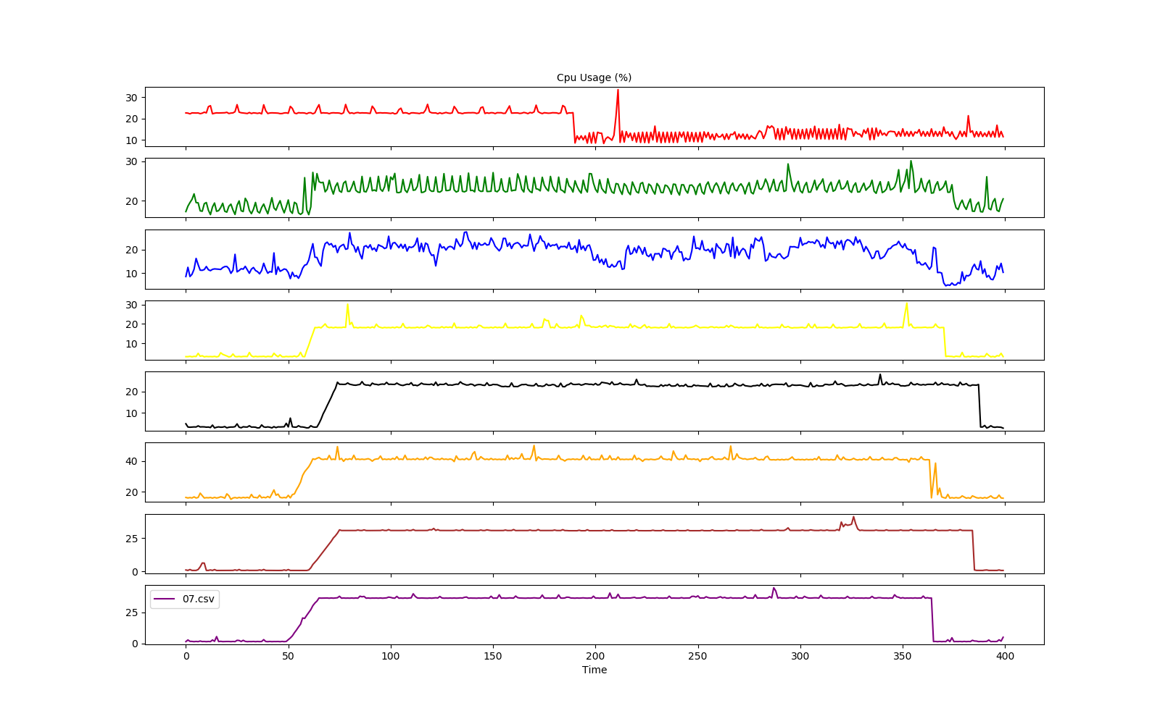

Algorithm Design Attribution Theory
Reasoning
Use historical data to learn historical behavior of metrics
Determine distinctiveness and consistency
E.g., Historical behavior = [A, A, B, C, Z, A, B]
At time t, compare current behavior of VMs
Hypervisor is faulty if:
high consensus and
(low consistency and/or high distinctiveness)
Observation | Interpretation | Attribution | Root Cause
Does the metric behaves this way when executing other workloads? | Yes. Low distinctiveness | Internal | Workload
 | No. High distinctiveness | External | Hypervisor
Do other metrics behave the same way when a hypervisor fails? | Yes. High consensus | External | Hypervisor
 | No. Low consensus | Internal | Workload
Does metrics behave this way historically? | Yes. High consistency | Internal | Workload
 | No. Low consistency | External | Hypervisor
1
HAD algorithm answers to 2 questions
2
Is the current behavior of the metric different from past behaviors (distinctiveness and consistency)?
3
Is there a consensus of metrics behavior across VMs (consensus)?
Behavior A
Behavior B
Behavior C
Behavior Z
VM1
VM2
VM3
VM4
VM5
VM6
VM7
Past
Current behavior
now (t)
now (t)
Current behavior
Note: Ideally, historical behavior should not include previous hypervisor failures. Once an hypervisor fails, its history needs to be deleted

Slide 18
Algorithm Design Procedure
Procedure
1. For each time series, find its change points
2. Using past behavior, dynamically filter change points
3. Find an area with a higher change density of change points across the various time series (consensus)
The presence of such an area is attributed to an hypervisor failure if it has not occurred in the recent past (distinctiveness and consistency)
1
2
3
2
3
1
For each VM
start
1. Find Change Points
2. Dynamic Filtering
3. Evaluate Density Change
end
Challenges
Parameter selection
thresholds, window size (3), …
Requires a set of online algorithms
Past
behavior
Current behavior
Current behavior

Slide 19
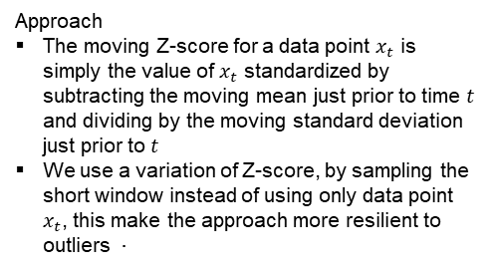
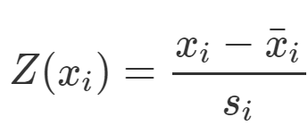
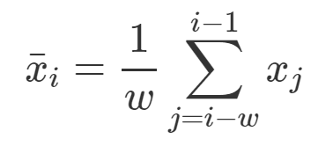
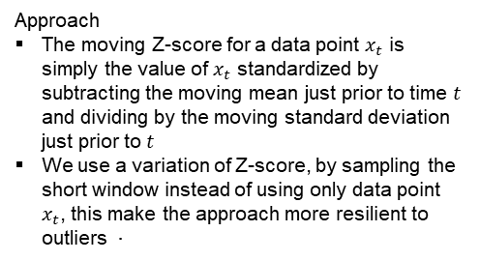
Algorithm Design Change Point detection
Moving Z-score. Score outliers in a univariate and sequential dataset, i.e., a time series. Fits a moving average to a univariate time series and identifies points that are far from the fitted curve.
Change Point techniques
Window-based (e.g., Z-score) O(n)
PELT (changes in mean, variance of time series) O(n)
bcp package (Bayesian single change point analysis of univariate time series)
Binary segmentation O(n log n)
Multivariate CP detection
EWMA
1. Change Point detector = z-score(long, short)
Short window
VMn
time-series
Long window
Approach
The moving Z-score for a data point $x_{t}$ is simply the value of $x_{t}$ standardized by subtracting the moving mean just prior to time $t$ and dividing by the moving standard deviation just prior to $t$
We use a variation of Z-score, by sampling the short window instead of using only data point $x_{t}$, this make the approach more resilient to outliers 
moving standard deviation
moving average

Slide 20
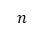
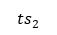
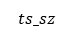
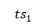
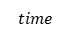
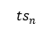
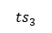
Algorithm Design Dynamic Filtering
Problem. When c change points are detected in a time series, is this observation historically consistent? The historical behavior of a time series needs to be considered to determine if the current behavior is different or not.
VM1
metric
Density D1
Density D2
Filtering techniques
Streaming Histograms
Kolmogorov–Smirnov test
Anderson-Darling (AD) test
VM2
metric
Past
behavior
Current behavior
Approach
Use a simple form of past behavior modeling by counting the number of change points which occurred in the past during the same interval of time
When a new change data point is detected, drop the point if it is below the count of past behavior
Queue Q
count = 2
drop 2 points
$$ts_sz$$
$${ts}_{1}$$
x
x
$${ts}_{2}$$
Solution. $O(n)$
$$n$$
$${ts}_{3}$$
function dynamic_filtering(queue, dp, threshold, mid):
if queue is full:
count = [1 if v > threshold else 0 for v in queue] past_behavior = sum(count[:mid]) curr_behavior = sum(count[mid:]) if curr_count < past_count: return True return False
…
$${ts}_{n}$$
$$time$$
Past
behavior
Current behavior

Slide 21
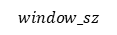
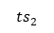
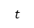
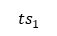
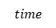
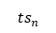
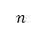
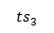
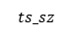
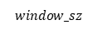
Algorithm Design Correlation strength
Problem (Min Color Count Over Intervals Problem (MinColorCount)). Given $n$ time series ${ts}_{i}$ , of lengths ${ts}_{sz}$, find the intervals with a maximum lengths of $window_sz$, which contain observations from $c$ time series.
Queue Q
Moving window
A data point is a tuple (color, timestamp)
New point arrives: update(x)
Case 1. distance between the timestamp of the new point and the start data point is < windows_sz
Enqueue data point x in Q
Case 2. distance between the timestamp of the new point and the start data point is >= windows_sz
Until the first point distance is lower than windows_sz, dequeue Q
Enqueue x
If queue q has more then c colors, emit queue state
$$ts_sz$$
$${ts}_{1}$$
$${ts}_{2}$$
$$n$$
$${ts}_{3}$$
Start data point in window
…
3 colors
…
$${ts}_{n}$$
$$t$$
$$time$$
$$window_sz$$
$$window_sz$$
Trivial solution. $O(n × ts_{sz}× window_sz)$
Online solution. $O(n × ts_{sz})$
function Overlap(x): (*)
for t in [0, ts_sz]:
color[0, n] = 0
for w in [t, t + window_sz]:
for i in [0, n]:
color[a[i][w]] = i
if |set(color[j] != 0)| > c:
print(t, color)
function Update(x):
while q is not empty:
if x.timestamp - q[0].timestamp >= windows_sz:
dequeue q
enqueue x in q
if |set(q[j].color)| > c:
print(q)
(*) Without loss of generalization, assume that all time series have the same length

Slide 22
Algorithm Design Interface and Parameters
Parameters
Parameters are derived from the implementation of the 3 features (change point detection, filtering and density change evaluation)
Parameter List
window_long_sz, window_short_sz
2 temporal windows used to detect change points over time series
threshold
Define the magnitude of a change point to be considered relevant due to its magnitude
dynamic_filtering
To reduce the number of false positives, dynamic filtering can be activated
overlap_min_pct
Percentage of time series (i.e., VMs) which need to be correlated to trigger an hypervisor anomaly
overlap_window_sz
Windows size used to detect a correlation between time series
online
Execute HAD as using a stream paradigm
class HAD(TimeseriesAlgorithm): """ Hypervisor Anomaly Detection (HAD) using Change Points,
dynamic filtering and Min Color Count Over Intervals """ name = 'had' version = '1.0' multivariate_test = True default_config = DEFAULTS @typechecked def __init__(self, window_long_sz: int = DEFAULTS['window_long_sz'], window_short_sz: int = DEFAULTS['window_short_sz'], threshold: float = DEFAULTS['threshold'], dynamic_filtering: bool = DEFAULTS['dynamic_filtering'], overlap_min_pct: float = DEFAULTS['overlap_min_pct'], overlap_window_sz: float = DEFAULTS['overlap_window_sz'], online: float = DEFAULTS['online'] ):
…

Slide 23
Metrics Collector
Download OS image
https://ubuntu.com/download/server
Create a VM
virt-install --name ubuntu-1 \
--memory 2048 \
--vcpus 2 \
--disk size=8 \
--cdrom /home/jcardoso/Downloads/ubuntu-23.10-live-server-amd64.iso \
--os-variant ubuntumantic
Configure OS
Follow the instructions on the screen to configure your new OS
Clone VMs
virt-clone --original ubuntu-1 --name ubuntu-2 --auto-clone
virt-clone --original ubuntu-1 --name ubuntu-3 --auto-clone
virt-clone --original ubuntu-1 --name ubuntu-4 --auto-clone
Install node exporter
sudo apt-get update
sudo apt-get install prometheus-node-exporter -y
sudo apt-get install prometheus-libvirt-exporter -y
sudo systemctl status prometheus-node-exporter
libvirt metrics: curl http://localhost:9177/metrics
OS metrics: curl http://localhost:9100/metrics

Slide 24
Injecting Stress
stress-ng --cpu 1 --cpu-cores 0,2
In this example, --cpu 1 instructs stress-ng to create 1 worker for CPU stress, and --cpu-cores 0,2 specifies that it should stress the CPU cores 0 and 2. Adjust the number of workers and the list of CPU cores based on your requirements.
cpulimit
The cpulimit command allows you to limit the CPU usage of a process.
# Install cpulimit on Debian/Ubuntu
sudo apt-get install cpulimit
# Limit CPU usage of process to 50%
cpulimit -e process_id -l 50
Workflow
1. Each VM is set to a CPU load of 50%:
stress-ng --cpu 2 --cpu-load 50 --timeout 60s
2. Limit CPU usage in qemu processes
for pid in `pgrep qemu-system-x86`; do echo $pid && sudo cpulimit -b -l 50 -p "$pid" ; done
3. Stop CPU limit
sudo killall cpulimit
#!/bin/bash
# Set the duration for each step (in seconds)
duration_per_step=5
n_cpu=2
# Function to run stress-ng with CPU stressor and specified load
run_stress_ng() {
local cpu_load=$1
if [ -z "$cpu_load" ]; then
echo "Load not assigned."
# Generates a random number between 0 and 99
cpu_load=$((RANDOM % 100))
fi
echo "Load has a value: $cpu_load"
stress-ng --cpu $n_cpu --cpu-load $cpu_load --timeout ${duration_per_step}s
}
echo "Simulating workload increase and decrease..."
for ((i = 1; i <= 10; i++)); do
run_stress_ng
done
echo "Workload simulation completed."

Slide 25
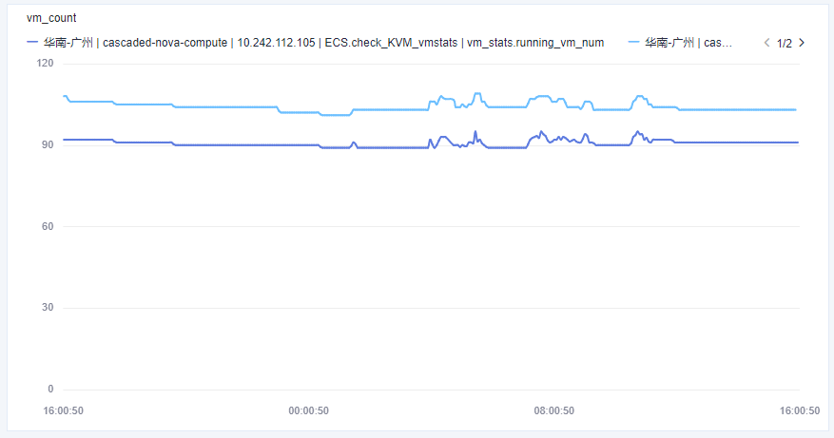
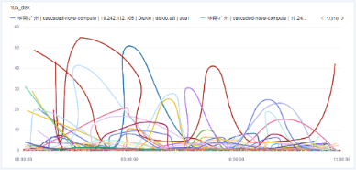
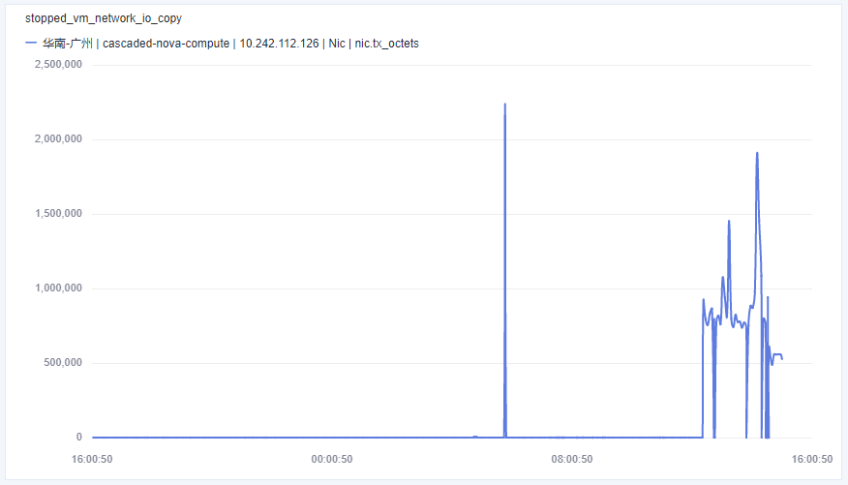
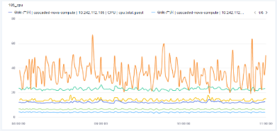
Experimental Testbed Overview
Testbed overview
Metrics similar to available in the Cloud
user workload
VM₁
VM_{N}
Load Script
Virtualization Layer
Prometheus
Number of VMs
Disk IO
Fault
metrics
Grafana
Role 2. Operations Generator
Role 1. Hypervisor host
Role 3. Monitoring
Network IO
CPU utilization
Node roles
Hypervisor host (KVM with VMs running on top of it)
Workload Generator (emulates user traffic for applications running in VMs)
Monitoring (metrics processing)
Fault Injection
Faults are injected to virtualization layer of hypervisor host: to hypervisor itself, host OS, virtual volumes and virtual networking
Type of VM workloads
Online shop: front-end, back-end and database. User requests are random
Monitoring database with uniformly-distributed write operations
CPU-bound operations, short-live with high CPU consumption and low IO
Almost idle: low CPU and low IO
Scenarios
Constant workload type, constant number of VMs: one case per type, plus one mixed consisting of VMs of different types of workload.
Constant workload, number of VMs changes over the time, e.g. some spawned, some removed.
Number of VMs changes and workload changes too.

Slide 26
Experimental Testbed Virtualization Platform and Metrics
Virtual Machines
Application VM N
Virtual Machine metrics
Application VM 1
Container
vcpu.N.time
Virtual CPU time spent by virtual CPU (https://libvirt.org/html/libvirt-libvirt-domain.html#virVcpuInfo)
Container
Container
Container
Container
Container
net.N.rx.(bytes|pkts|errs|drop)
Received bytes, packets, errors or dropped
net.N.tx.(bytes|pkts|errs|drop)
Transmitted bytes, packets, errors or dropped
vCPU 0
vCPU 1
vCPU 0
vCPU 1
Hypervisor
KVM
block.N.rd.(reqs|bytres|times)
Number of read requests, bytes read and time spent on reads
block.N.wr.(reqs|bytres|times)
Number of write requests, bytes written and time spent on writes
Linux kernel
OVS (virtual networking)
Storage (LVM or network)
Physical Layer
CPU 0
CPU 1
CPU N
ethN
ethN
/dev/sda
/dev/sdN
Host Metrics
cpu.(time|user|system|wait|idle) System CPU metrics including user-space, kernel and i/o
net.N.rx.(bytes|pkts|errs|drop)
Received bytes, packets, errors or dropped
net.N.tx.(bytes|pkts|errs|drop)
Transmitted bytes, packets, errors or dropped
block.N.rd.(reqs|bytres|times)
Number of read requests, bytes read and time spent on reads
block.N.wr.(reqs|bytres|times)
Number of write requests, bytes written and time spent on writes

Slide 27
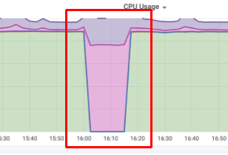
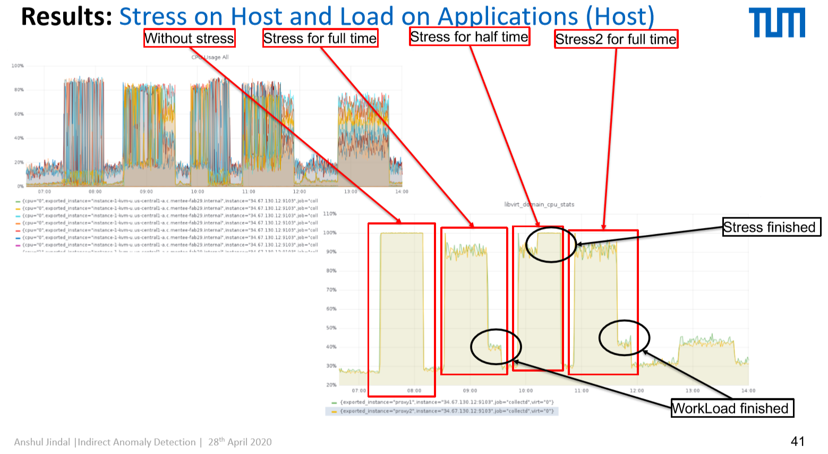
Experimental Testbed Faults List
Fault
Impact on the virtualization layer
Impact on metrics (expectation)
High CPU consumption by OS kernel of hypervisor host
Injection is done by using `stress-ng` tool with stressor affecting kernel space.
Host kernel consumes a lot of CPU

Slide 28
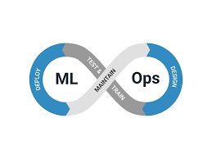
Experimental Testbed Evaluation Framework
Scenario
Data Generation
Algorithm
Test Module
Parameters:
VM count
VM load profile (e.g. CPU consumption)
Generate synthetic metrics and labels
Synthetic data
Evaluation using labels
Calculate scores (precision, recall, F1)
Parameters:
VM count
VM load profile (e.g. CPU consumption)
Fault injection time
Fault strength
Deploy VMs
Generate user workload
Inject faults and record time (used as labels)
Collect metrics from hypervisor
Download metrics
Apply algorithm
Simulated data
Run algorithm
Evaluate
Improve algorithm
Download the data from CloudMonitor
Manually label the data
Real cloud data

Slide 29

Experimental Testbed Algorithm
Input: one time-series per VM
Input:
Set of time-series – one per VM
Algorithm parameters:
Window size – number of points to take into account for change point detection
Change threshold – how sensitive change point detection to feature variation
Output:
True, if there is an anomaly in time t
Select window [t-w, t]
For each VM
Done
Detect change point
Has change point?
N
Intersect change points
Y
Has intersection?
Y
Store change point in the list
No anomaly
Anomaly reported

Slide 30
Experimental Testbed Baseline Algorithm Evaluation
Positive case
Negative Case
Evaluation is done with 20 time-series, change threshold 5% and window size from 10 to 60 points
Further (future) improvements
Voting threshold < 100%
Handle a case when change point detected not in exact time but with small variation
Improve change point detection algorithm (more sophisticated then just mean value)

Slide 31
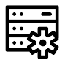
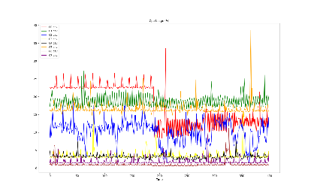
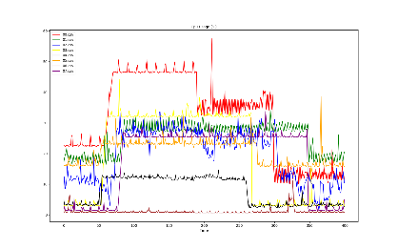


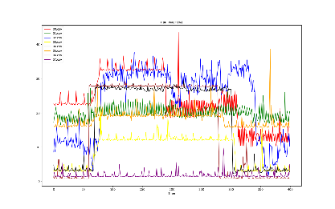
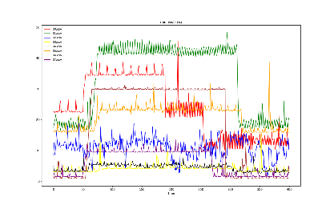
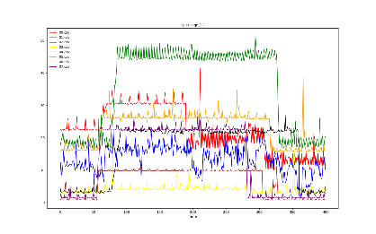
Evaluation (semi-synthetic) Dataset Generation
Normal
Abnormal
VM data
Generate
Synthetic Data
Hypervisor 1
Change
base signal
Open Datasets
Generators
(e.g., random)
Hypervisor 2
Other datasets used in previous experiments
Hypervisor 3
 | Dataset | Time Ticks | Number of VMs | Positive Cases | Negative Cases
1 | Synthetic Dataset [1] | 1000 | 10 | 5 | 5
2 | Experimental Synthetic Merged Dataset [2] | 5400 | 2 + 8 (synthetic) | 42 | 17
3 | Microsoft Azure Dataset*[3] | 5400 | 10 | 16 | 10
4 | Alibaba Dataset*[4] | 5400 | 10 | 10 | 10
…
Hypervisor n

Slide 32
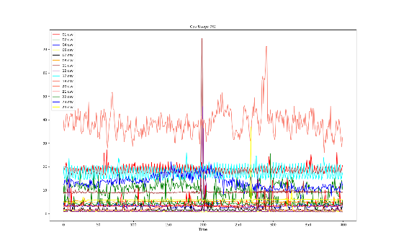
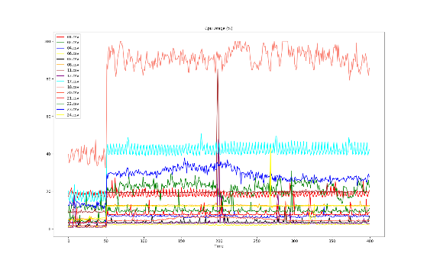
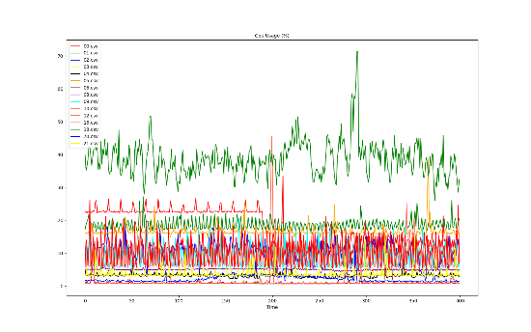
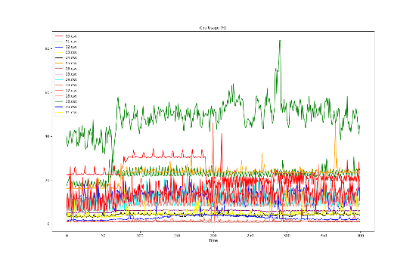
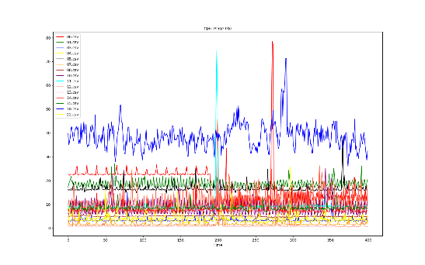
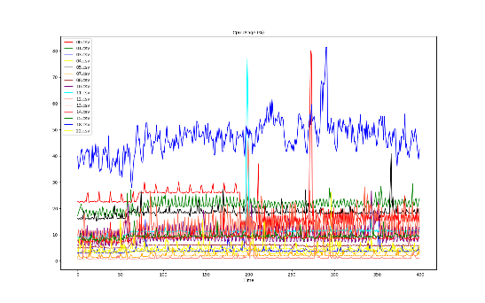
Evaluation (semi-synthetic) Dataset Generation
Example of a dataset generator for test case: 'random_hard’
Normal
Hypervisor anomaly
Abnormal
def gen_random_hard(): n_ts = 30 return { 'env': { 'name': 'random_hard', 'description': 'Increase 20%-50% (with delay 0-30, width 1-15) in 90% VMs', 'n_hypervisors': 5, 'n_vms_sets': [10, 15], }, 'data': { 'src_data_dir': os.path.abspath('../datasets/azure/normal/'), 'dst_data_dir': os.path.abspath('./.data/azure/random_hard/'), 'ts_len': 575, 'ts_anomaly_point': 50, 'n_ts': n_ts, 'ts_percentage_affected': .9, 'ts_increase_width': np.random.randint(1, 15, size=n_ts, dtype=int).tolist(), 'ts_increase_delay': np.random.randint(0, 30, size=n_ts, dtype=int).tolist(), 'ts_increase_height_percentage': np.random.uniform(0.2, 0.5, size=n_ts).tolist(), 'ts_stay_width': np.random.randint(200, 220, size=n_ts, dtype=int).tolist(), 'ts_decrease_width': np.random.randint(1, 5, size=n_ts, dtype=int).tolist(), 'ts_decrease_height_percentage': np.random.uniform(0.0, 0.0, size=n_ts).tolist(), 'ts_decrease_delay': np.random.randint(1, 40, size=n_ts, dtype=int).tolist(), }, 'param_grid': { 'window_long_sz': [25, 30, 40], 'window_short_sz': [10, 20], 'threshold': [1.6, 1.8, 2.0, 2.2], 'dynamic_filtering': [True, False], 'overlap_min_pct': [.7, .8, .9], 'overlap_window_sz': [30], 'online': [True], }, 'optimization': [ Integer(25, 40, name='window_long_sz', dtype=int), Integer(10, 20, name='window_short_sz', dtype=int), Real(1.8, 2.1, name='threshold', dtype=float), Integer(0, 1, name='dynamic_filtering', dtype=int), Real(.6, .8, name='overlap_min_pct', dtype=float), Integer(40, 60, name='overlap_window_sz', dtype=int), ] }
Simulation
environment
Hypervisor 1
Data
generation
Generators
Random easy
Random hard
Random difficult
Parameter
grid search
Parameter
optimization
Each test case: 5 hypervisors with 30 VMs each

Slide 33

Evaluation (semi-synthetic) Dataset Generation
ts_percentage_affected
Generators Key Parameters
n_ts
Number of time-series (VMs) to generate
ts_anomaly_point
timestamp when an anomaly occurs
ts_percentage_affected
Percentage of ts affected by the anomaly
ts_increase_delay
Number of data points after the anomaly at which VMs are affected
ts_increase_height_percentage
Percentage of ts change after anomaly
ts_increase_width
Width of ts change after anomaly
ts_stay_width
Width of stay after degradation
ts_decrease_delay
Number of data points after stay period
ts_decrease_height_percentage
Percentage of change after stay period
ts_decrease_width
Width of ts change after stay period
ts_increase_delay
ts_increase_height_percentage
ts_increase_width
ts_len
ts_anomaly_point
ts_stay_width
n_ts
Hypervisor anomaly
Degradation period

Slide 34

Evaluation (semi-synthetic) F1, precision, recall
Selecting Parameters for Evaluation
Apply Bayesian optimization on random diff(icult) scenario to identify best parameters for addressing difficult cases
Select random set of parameters from best sorted set
Selected parameters
{'window_long_sz': 30.933333333333334, 'window_short_sz': 17.8, 'threshold': 1.9886447684992719, 'overlap_min_pct': 0.7206731936373396, 'overlap_window_sz': 51.0}
Note: depending on the results from running HAD in production, the technique to find the pseudo optimal parameter set needs to be revised
Procedure
Generate 3 types of datasets for hypervisors
Random easy, random hard, random difficult
Evaluation HAD on all 3 scenarios (e.g., random easy, random hard, …) by varying the number of VMs managed by hypervisor
Calculate F1, precision and recall
Evaluation Results
In general, the results are excellent at # VMs > 13
For scenario 1) and 2), precision = 1, when # VMs > 13
No false positives
Recall is also good for these scenarios
With the current implementation, a few hypervisor failures will not be caught when the # of VMs is low (# VM < 14)
# VMs > 13 VMs
F1 = 1 or precision = 1.0
Scenario name
Good results
8 > # VMs > 14
Excellent results
# VMs > 13
Most probable production scenario
Good results
8 > # VMs > 14
Excellent results
# VMs > 13
Good results
8 > # VMs > 14
Excellent precision
# VMs > 13
F1, precision, recall

Slide 35


Evaluation (semi-synthetic) User Interface
Dashboard
Shows the heath status of hypervisors (9 hypervisors are shown)
Beige background indicates a problem
Background color indicated correlation
Each hypervisor shows the volatility of the managed VMs
High bars indicate high volatility
PinPoint Visualization
Detailed visualization on the behavior of VMs’ signals
Change points and overlapping regions are shown
VM 01
VM 02
Dashboard
Background
Hypervisor anomaly
VM 03
VM 04
Red line
Volatility correlation degree among VMs
VM 05
VM 06
Bars
VM volatility
VM 07
Most VMs have a low or no volatility. Thus, hypervisor is healthy
VM n
Note: the correlation degree determines if the volatility of VMs is, or is not, related to the volatility/churn of workloads
Vertical overlaps represent the correlation of behavior change as a consequence of, e.g., an hypervisor failure. The number of horizontal overlaps indicate the confidence of an anomaly.

Slide 36


Evaluation (semi-synthetic) Performance: Online vs Offline
Limitations of offline HAD
Uses 2 sliding windows: mean and std are expensive to recompute
Effect of time series size on running time
1 hypervisor; 1 second sampling; 25 VMs
Monitoring duration: 1h, 2h, 3h, 4h, 5h, 6h
Online improvements: 4x (1h) to 13x (6h)
Effect of window size on running time
1 hypervisor; 1 second sampling; 25 VMs
Sliding windows size: [16, 32, 64, 128, 256, 512, 1024, 2048], 15
Monitoring duration: 6h
Online improvements: 5.5x (sz: 16) to 18x (sz: 2048)
HAD Performance Analysis: Online vs. Offline (windows = (100, 25))
High performance improvements recommend to adopt streaming technologies for monitoring
Offline
Time (sec)
13x improvement
+--------------+------+----------------+-----------------+-----------------+------------------+-------------+--------------+
| n_datapoints | n_ts | window_long_sz | window_short_sz | improvement_pct | improvement_fold | online_mean | offline_mean |
+--------------+------+----------------+-----------------+-----------------+------------------+-------------+--------------+
| 3600 | 25 | 100 | 25 | 23.96 | 4.17 | 0.04 | 0.17 |
| 7200 | 25 | 100 | 25 | 19.41 | 5.15 | 0.07 | 0.35 |
| 10800 | 25 | 100 | 25 | 17.52 | 5.71 | 0.1 | 0.55 |
| 14400 | 25 | 100 | 25 | 16.38 | 6.1 | 0.13 | 0.8 |
| 18000 | 25 | 100 | 25 | 18.25 | 5.48 | 0.19 | 1.06 |
| 21600 | 25 | 100 | 25 | 13.52 | 7.39 | 0.17 | 1.22 |
+--------------+------+----------------+-----------------+-----------------+------------------+-------------+--------------+
4x improvement
Online
Time-series size
HAD Performance Analysis: Online vs. Offline (8 ts * 10k data points)
Offline
+--------------+------+----------------+-----------------+-----------------+------------------+-------------+--------------+
| n_datapoints | n_ts | window_long_sz | window_short_sz | improvement_pct | improvement_fold | online_mean | offline_mean |
+--------------+------+----------------+-----------------+-----------------+------------------+-------------+--------------+
| 80000 | 8 | 16 | 15 | 17.76 | 5.63 | 0.75 | 4.21 |
| 80000 | 8 | 32 | 15 | 19.32 | 5.18 | 0.87 | 4.53 |
| 80000 | 8 | 64 | 15 | 18.45 | 5.42 | 0.88 | 4.76 |
| 80000 | 8 | 128 | 15 | 15.38 | 6.5 | 0.84 | 5.44 |
| 80000 | 8 | 256 | 15 | 12.26 | 8.16 | 0.83 | 6.74 |
| 80000 | 8 | 512 | 15 | 9.85 | 10.15 | 0.92 | 9.36 |
| 80000 | 8 | 1024 | 15 | 9.57 | 10.45 | 1.35 | 14.11 |
| 80000 | 8 | 2048 | 15 | 5.45 | 18.34 | 1.49 | 27.24 |
+--------------+------+----------------+-----------------+-----------------+------------------+-------------+--------------+
Time (sec)
18x improvement
5.5x improvement
Online
Windows size

Slide 37
Evaluation (semi-synthetic) Conclusions
Assumptions
CPU is the best metric to predict hypervisors’ anomalies
Hypervisor anomalies cause changes in CPU mean and std. 3 scenarios exist:
Increase 100%-150% (with delay 0, width 1) in 90% VMs
Increase 20%-50% (with delay 0-15, width 1-15) in 90% VMs
Increase 10%-30% (with delay 0-15, width 1-15) in 90% VMs
HAD algorithm
Compare change point approaches with knee or trend identification
Static training with holistic CPU model
Dynamic training
Effect of low CPU on false positives (e.g., the increase of 100% of a low metrics can be false positive dues to glitches and sudden increases of OS processing)
Variable threshold as a function of the number of VMs running in an hypervisor
Next steps
Evaluate HAD with production data
Decide between using the offline or online implementation
Prepare system design
Code goes to production (to be included in CAD)
Further research
Can hypervisor application logs also be used?
Can kvm_stat (which monitors more than 30 hypervisor metrics) also be used?

Slide 38



Evaluation (CloudScope / CMC) Insights on VM metrics
Case 1) Periodic
Case 2) Insufficient number of VMs
Case 3) Insufficient
Number of observations
Only 6 observations
Only 1 observations
Only 2 observations
hypervisor = 3ee01be4-69ec-48f8-86cf-d5b9ec17d8b9

Slide 39
Evaluation Baseline
Sr No. | Algorithm | Input | Parameters
1 | IAD | timeticks x num_vms | Window Size, Threshold, Percentage VMs Anomalous
2 | ECP[5] | timeticks x num_vms | # of change points, Minimum number of observations between change points
3 | BNB[6] | timeticks x num_vms | Window Size, number of trees, threshold for change points
4 | BNBOnline[7] | timeticks x num_vms | Window Size, number of trees, threshold for change points
5 | Isolation Forest[8] | timeticks x num_vms | contamination factor, requires training
6 | Isolation Forest with Features | timeticks x num_features | contamination factor, requires training
Sr No. | Algorithm | Synthetic | Experimental Synthetic Merged | Azure | Alibaba
1 | IAD | 0.96 | 0.86 | 0.96 | 0.57
2 | ECP[5] | 0.67 |  | 0.76
3 | BNB[6] | 0.62 | 0.90 | 0.8 | 0.33
4 | BNBOnline[7] | 0.87 | 0.81 | 0.86 | 0.4
5 | Isolation Forest[8] | 0.76 | 0.83 | 0.76 | 0.66
6 | Isolation Forest with Features | 0.76 | 0.83 | 0.76 | 0.66

Slide 40
Conclusions Challenges
Improvements
How to handle seasonality at low cost?
How to handle noise?
Update Dashboard to handle between 1 and 9 hypervisors with 8-20 VMs

Slide 41
Related Work
https://cran.r-project.org/web/packages/ecp/vignettes/ecp.pdf
https://bhooi.github.io/papers/bnb_sdm19.pdf
https://scikit-learn.org/stable/modules/generated/sklearn.ensemble.IsolationForest.html

